Slide 1
Trackr - Iteration 1
Presentation / Demo
BU MET CS 673 (Summer 1 2022)
Group 1: Jean Dorancy, Timothy Flucker, Xiaobing Hou, Weijie Liang

Slide 2
Outline
Project Overview
Project Architecture
Development Completed this Iteration
Testing Overview
Unit Testing Coverage Report
Deployment Overview
Next Steps

Slide 3
High Level Project Overview
Description: Trackr is a an application that is meant to be an alternative to financial tracking applications such as Mint and Truebill.
Goal: A way for users to view transactions against their bank accounts so that they can understand their overall financial well-being and spending behavior.
Implementation:
Spring Boot Application for REST APIs
React for the frontend
Deployed on Heroku as Docker container
Postman for manual and JUnit for automated testing

Slide 4
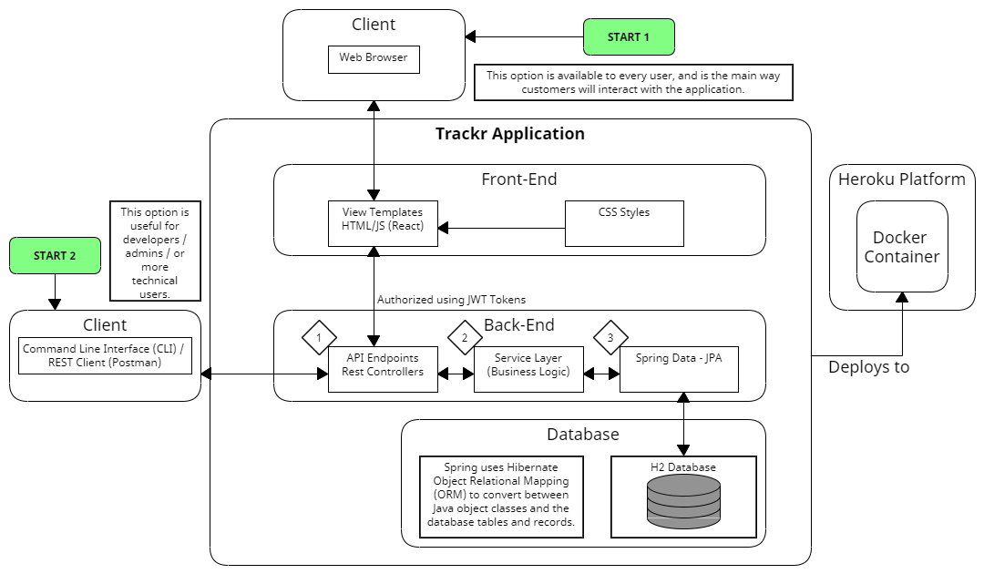
Project Architecture

Slide 5
Development Completed
API
Web GUI
Configuration
User Management
Register new user
Generate new JWT Token
Bank Account Management
Create new Bank Account
Modify Bank Account
Deactivate Bank Account
Transaction Management
Find all Transactions
Find Transaction by ID
Create new Transaction
Modify Transaction
Deactivate Transaction
User Registration Page
User Login Page
Home Page
Dockerize App
Deployment w/ GitHub Integration
Development
Production
JavaScript Code Sniff Pipeline

Slide 6
Testing Overview
Automated
JUnit5 and Mockito used for Unit tests
41 tests
8 test classes
Manual
Postman
Shared Postman collection (saved in the project repository)
Web GUI
Create user account
Login with valid credentials
Test invalid scenarios (invalid credentials/existing username)

Slide 7
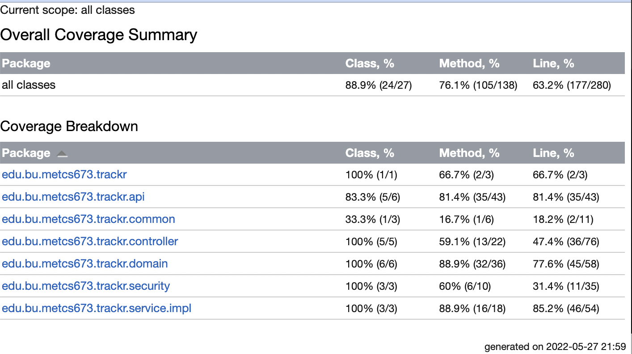
Unit Testing Coverage Report

Slide 8
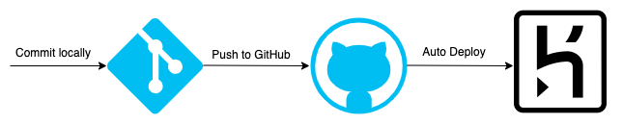
Deployment Overview
Commit locally
Push to GitHub
Open PR
Checks
Feedback
Approval
Merge
Merges to main and development branches trigger auto deploy
Any other branch manual with Heroku deploy tool
App is deployed as a Docker container to Heroku

Slide 9
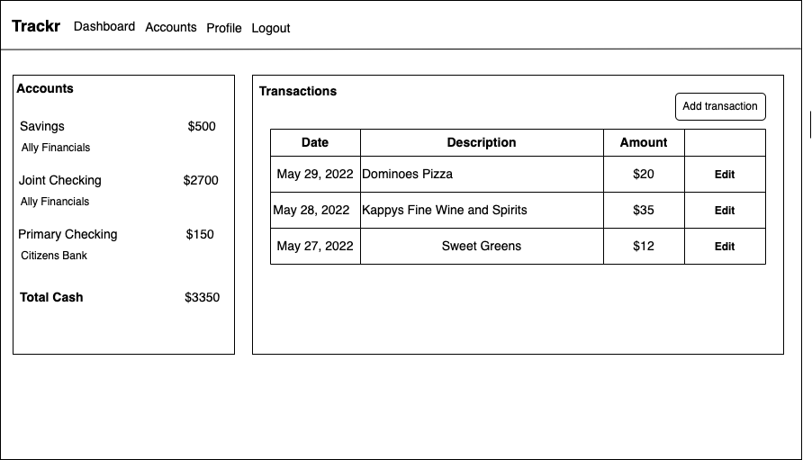
Next Steps
Dashboard Page
All Accounts Page
User Profile Page
Refactoring
Security
SQL Injection
Cross-Site Scripting
Session Management
HTTPS Connection

Slide 10
Demo Content
API Demo (Postman)
Create user
Retrieve new token
Create Bank Account
Web GUI deployed to Heroku Demo
User Registration
User Login
Show automated test
Mockito

Slide 11
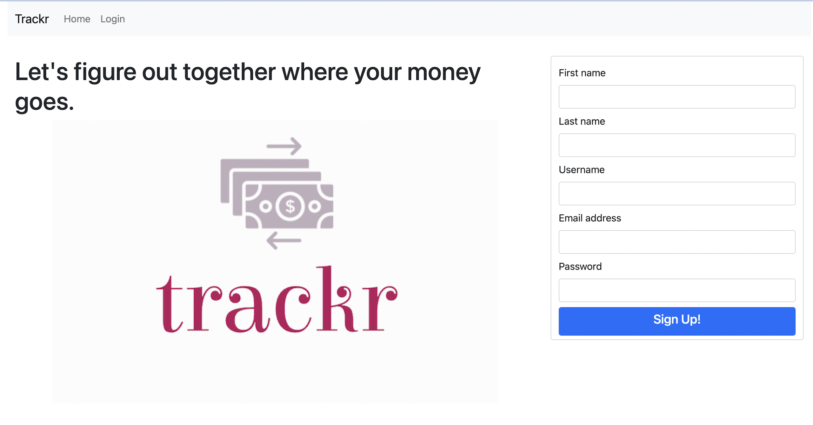
Thank You!

